Slide 1


          University of Diyala
          College of Engineering
          Department of Electronics Engineering
Course Number: U103
Course Name: Computer Science
Lecture (7)
Asst. Lect. Wurod Qasim Mohamed

Slide 2
                Microsoft office Word

Slide 3
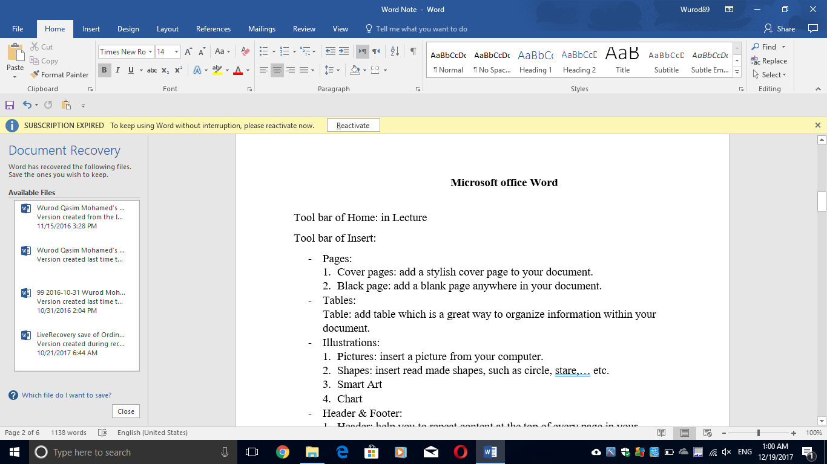

Slide 4
Tool bar of Home:
Clipboard:
  Cut (Ctrl + X): Remove the selection and put it on the clipboard so you can paste it somewhere else.
  Copy (Ctrl + C): put a copy of the selection and put it on the clipboard so you can paste it somewhere else.
  Format Painter (Ctrl + Shift + C), (Ctrl + Shift + V): Like the look of a particular selection.
  Paste (Ctrl + V): add the content on the clipboard to your document.

Slide 5
Fonts:
  Pick a new font for your text
  Change the size of your text
  Change case of your text
  Clear All Formatting
  Font color: to change the color of your text
  Text highlight color: Make your text pop by highlighting it in a bright color.
  Bold (Ctrl + B): make you text bold
  Italic (Ctrl + I): Italicize your text
  Underline (Ctrl + U): underline your text
  Strike through: cross something out by drawing a line through it.
  Subscript (Ctrl + =): type very small letters just below the line of text.
  Superscript (Ctrl + +): type very small letters just above the line of text.

Slide 6
Paragraph:
Align left (Ctrl + L): align your content with the left margin
Center (Ctrl +E): center your content in the page
Align right (Ctrl + R): align your content with the right margin
Justify: distribute your text evenly between the margins
Line and paragraph spacing: choose how much space appears between the lines of text or between paragraph.
Left to Right Text Direction: set the text to read from left to right.
Right to Left Text Direction: set the text to read from right to left.
Decrease Indent: Move your paragraph closer to the margin.
Increase Indent: Move your paragraph farther away from the margin.

Slide 7
Styles: help you to give your document a consistent, polished look.
Editing:
Find (Ctrl + F): help you to find text or other content in the document.
Replace (Ctrl + H): help you to search for text you would like to change and replace it with something else.

Slide 8
Tool bar of Insert:
Pages:
Cover pages: add a stylish cover page to your document.
Black page: add a blank page anywhere in your document.
Tables:
Table: add table which is a great way to organize information within your document.

Slide 9
Illustrations:
Pictures: insert a picture from your computer.
Shapes: insert read made shapes, such as circle, stare,… etc.
Smart Art
Chart
Header & Footer:
Header: help you to repeat content at the top of every page in your document.
Footer: help you to repeat content at the bottom of every page in your document.
Page number: help you to number the pages in your document

Slide 10
Text:
Text Box: help you to insert a text box to bring a focus to the content that contains.
Word Art: help you to add some artistic flair to your document.
Symbols:
Equation: (Ctrl + =) help you to add common mathematical equations to your document.
Symbol: help you to add symbol that are not on your keyboard.

Slide 11
Tool bar of Page Layout:
Page setup:
Margin: help you to adjust margins of your document.
Tool bar of Review:
Spelling and Grammar (F7): help you to check your spelling and grammar in your document.
Tool bar of View:
Views:
Print layout: help you to see the document look if printed.
Show:
Ruler: show rulers next to your document.
Gridline: Show gridline in the background of your document.
Zoom: help you to zoom your document to view for example view in one page or multiple pages. Also, zoom your document to any percentage like 200%

Slide 12
Tool bar of File
Inf. : provide you information about your document.
New: help you to open a new document of Microsoft office word.
Open: help you to open a document that already there in your computer.
Save: help you to save the changes that you made in the same document.
Save as: to save the changes that you made will whole document in the separate a new document with a new name file.
Print: help you to print your document by connecting your computer to the printer.
Close: help you to close the selected document without closing the Microsoft office word program.

Slide 13
Practical Laboratory Part

